Slide 1
SnowFlake Workshop Dubai Airports

Slide 2
Speech to Text
01
Text to Speech
02
Document - AI
03
Oracle CDC
04
Box Integration
05

Slide 3


ABOUT NICE
We are one of the top business intelligence solutions companies, experts in producing quicker & impactful Self Driven BI applications which can enhance your business growth.
NAGPUR (CORPORATE OFFICE )
21, IT Park, Wing-A,
Ground Floor, Gayatri Nagar, Nagpur - 440022 (India)
PUNE
Marisoft Tech Park, Marigold Complex, Tower 1, 104, 1st Floor, Kalyani Nagar, Pune – 411014 (India) | Maharashtra
DUBAI
Level 20 S3 Sky-lobby Burjuman Business Tower Mankhool
Bur-Dubai

Slide 4
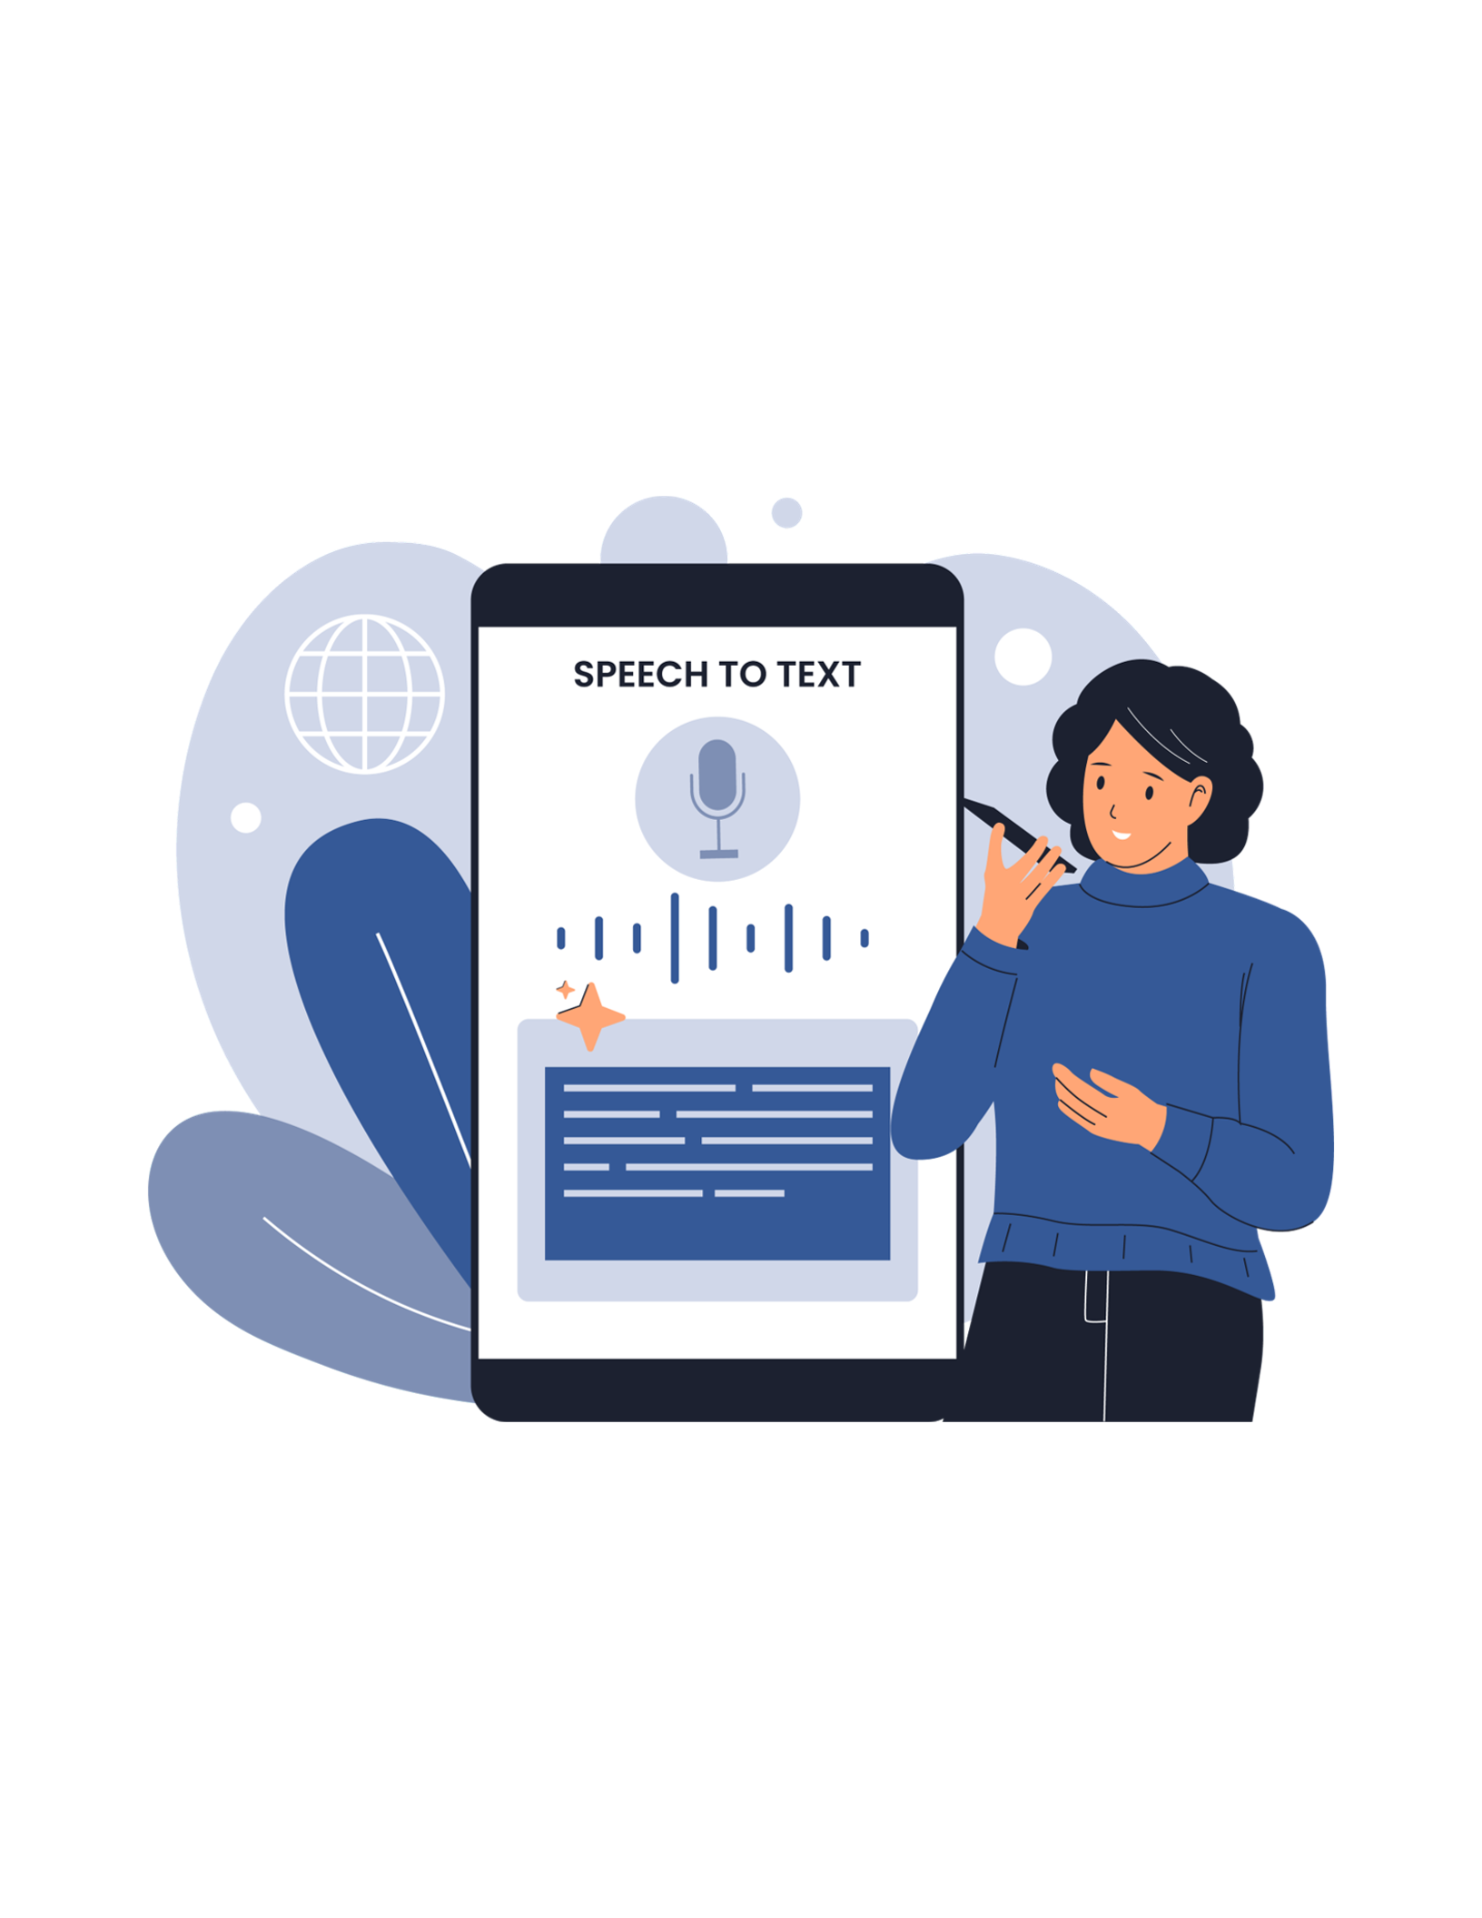
Speech to Text
We want to audit the conversations happening in our call center and want to create analytics whether they’re aligned with company standards. ​
Like did they introduced the company name properly?​
Or
Did they asked if they could assist them further​?
Disclaimer​
Used default STT model with no tuning​
Used default LLM models with no tuning​
Hence expect some delusions and accuracy problems​
We’ll mainly use below functions while the implementation
AI_TRANSCRIBE​
AI_SENTIMENT​
AI_COMPLETE​

Slide 5
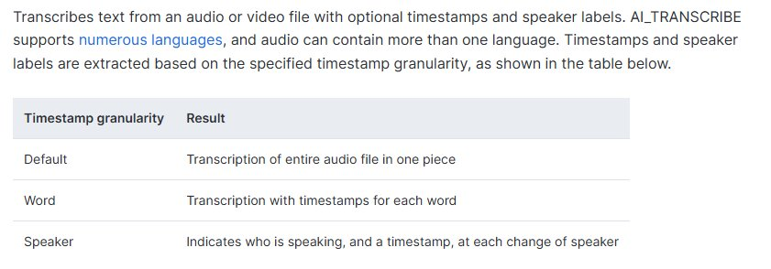
Speech to Text – AI_TRANSCRIBE
Syntax
AI_TRANSCRIBE( <audio_file> [ , <options> ] )
https://docs.snowflake.com/en/sql-reference/functions/ai_transcribe

Slide 6
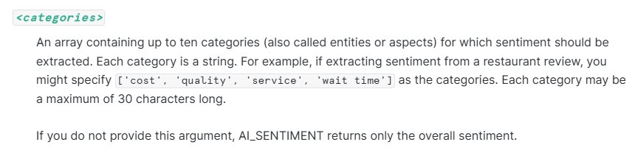
Speech to Text – AI_SENTIMENT
Returns overall and category sentiment in the given input text.​
Syntax
AI_SENTIMENT( <text> [ , <categories> ] )
https://docs.snowflake.com/en/sql-reference/functions/ai_sentiment

Slide 7

Speech to Text – AI_COMPLETE
Generates a response (completion) from text or an image using a supported language model. You can provide:​
A text prompt, to generate a response from the model. ​
A single image and a text prompt, to generate a response based on the image and prompt. ​
A prompt object that can support multiple images and text.​
Syntax
AI_COMPLETE ( <model>, <prompt> [ , <model_parameters>, <response_format>, <show_details>, <return_error_details> ] )
https://docs.snowflake.com/en/sql-reference/functions/ai_complete-single-string

Slide 8

Text to Speech
Target is to create a TTS model trained for a specific voice for each language and can generate voice files for the announcements
Gate Announcements
KIOSK automations
Crew radio automation
Etc.
Current model is trained with some random voice samples
Can be provided as an API or deployed on to SF environment with containers.
Currently we do support 17 languages, but this number can be extended
English, Spanish, French, German, Italian, Portuguese, Polish, Turkish, Russian, Dutch, Czech, Arabic, Chinese, Japanese, Hungarian, Korean, Hindi

Slide 9
Document AI

Slide 10
Scenarios Will be Covered
Parsing a document into text/json (AI_PARSE_DOCUMENT)​
Asking questions directing to the document parsed (AI_COMPLETE)​
Asking questions directing to nor parsed file (AI_EXTRACT)​
Analyzing multiple files in a single pass (RELATIVE_PATH)​
Comparing documents to each other by using all of above.​

